Slide 1
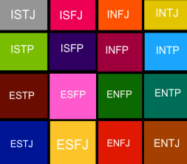
MBTI and Team Dynamics

Slide 2
AGENDA
 | ACTIVITY
 | Welcome and MBTI Sprint What is it? Benefits
 | Validating Your Type (includes Break) Large group exercises Individual report study/capture highlights
 | MBTI and Teams Team sharing of individual highlights Z problem solving model Team activity
 | Our Path Forward Forward Imaging* More of/Less of* *Accelerating Change Effectively (ACE) tools
 | Going Forward-Personal Commitment Individual More of/Less of*
 | Wrap Up

